Slide 1
Chapter 5

Slide 2
Objectives

Slide 3
Objectives (cont.)

Slide 4
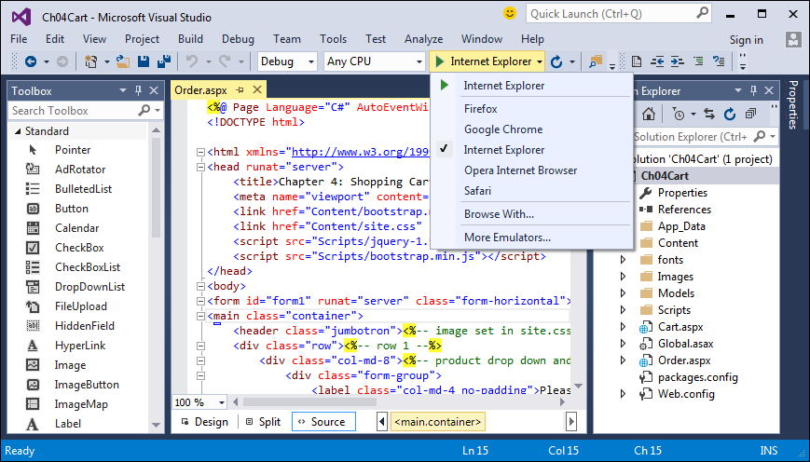
The browser menu in the Standard toolbar

Slide 5
How to run an application in the default browser with debugging

Slide 6
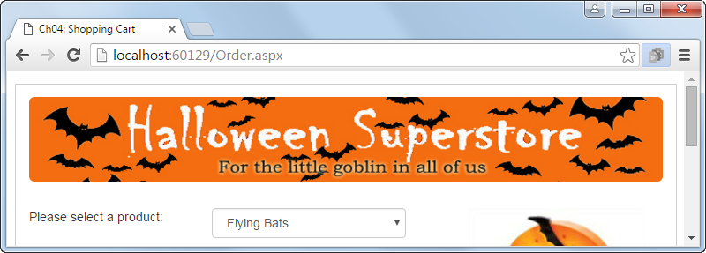
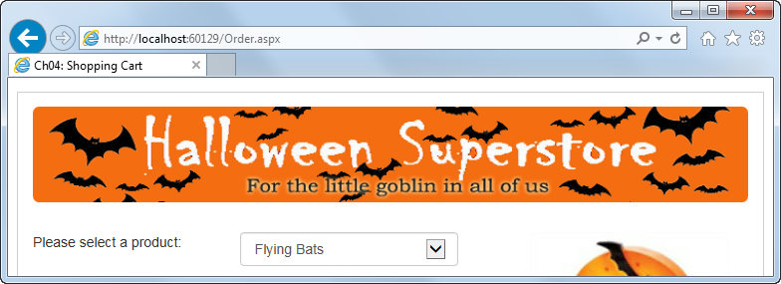
The Cart app in Chrome and IE at the same time

Slide 7
The Refresh button in the Standard toolbar

Slide 8
The Browser Link menu in the Standard toolbar

Slide 9
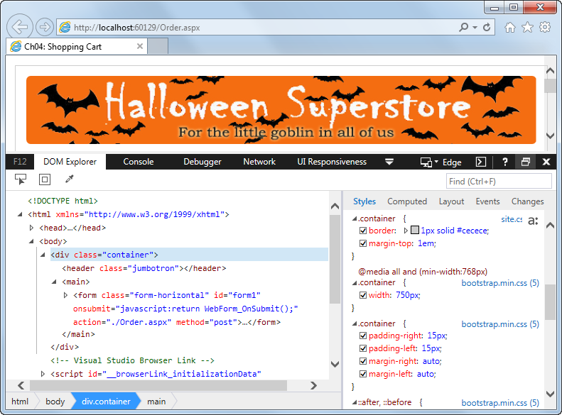
IE with the DOM Explorer of the developer tools

Slide 10
How to open and close the developer tools in Chrome, Firefox, and IE

Slide 11
How to view the rendered HTML and CSS styles

Slide 12
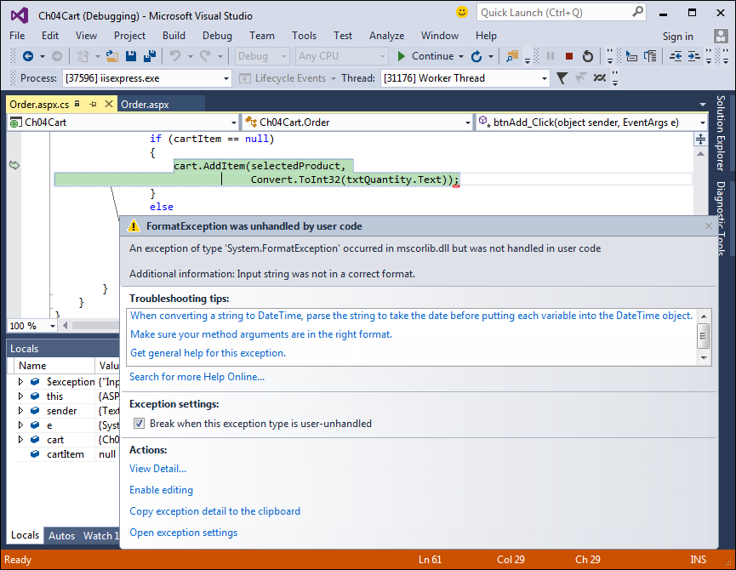
The Exception Assistant dialog box

Slide 13
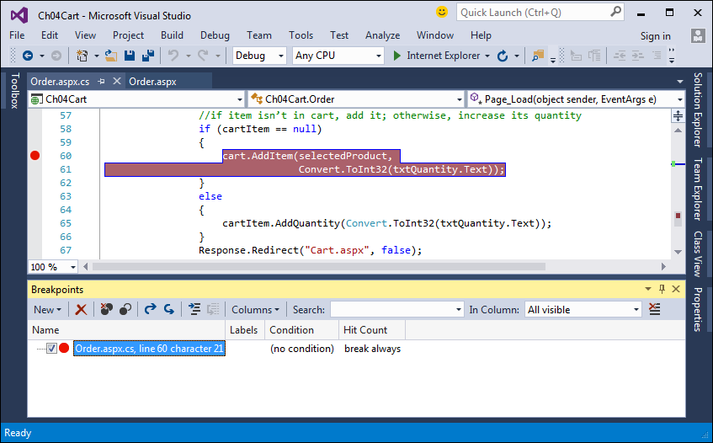
The Order page with a breakpoint

Slide 14
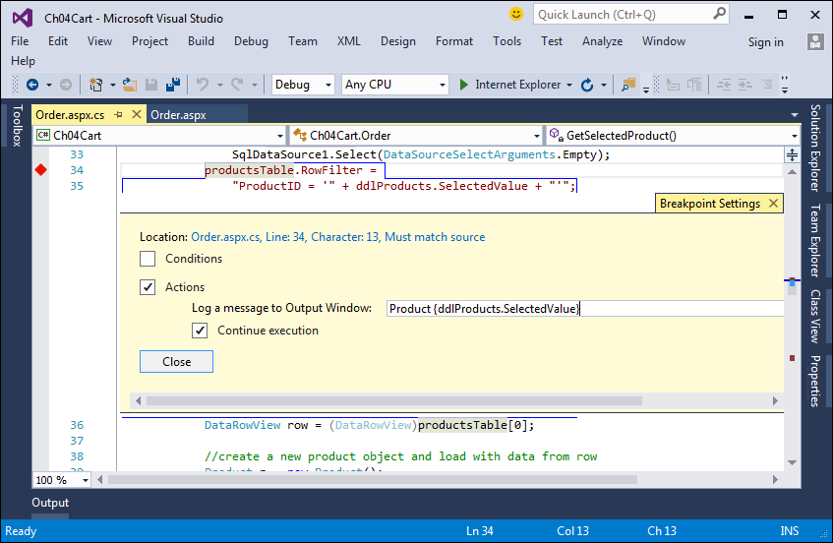
The Order page with a tracepoint in the Breakpoint Settings window

Slide 15
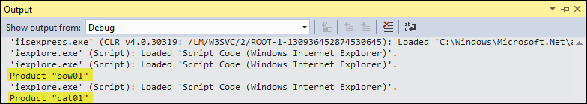
Output from the tracepoint in the Output window

Slide 16
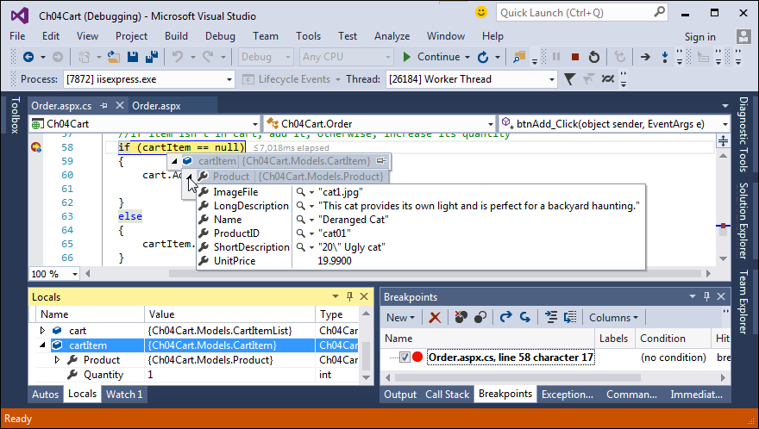
The Shopping Cart application in break mode

Slide 17
Commands in the Debug menu and toolbar

Slide 18
The Locals window

Slide 19
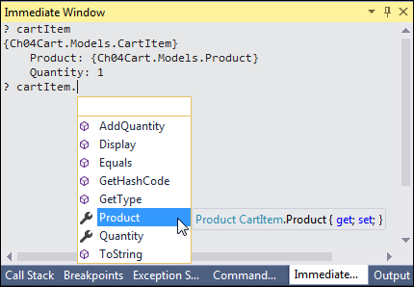
The Immediate window

Slide 20
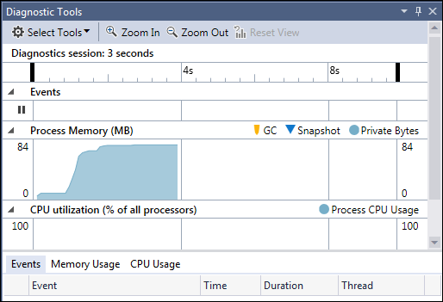
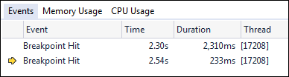
The Diagnostic Tools window with a close up of the Events tab

Slide 21
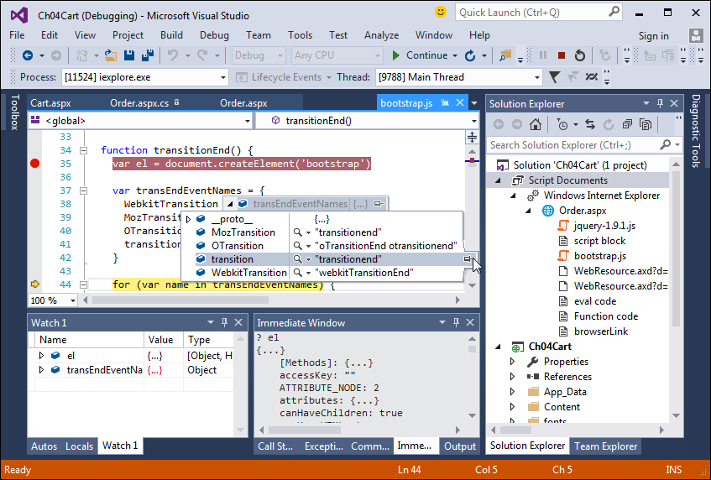
The bootstrap.js file in break mode

Slide 22
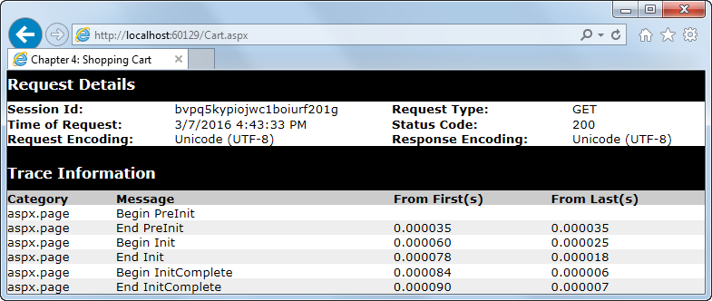
The start of the trace output for the Cart page

Slide 23
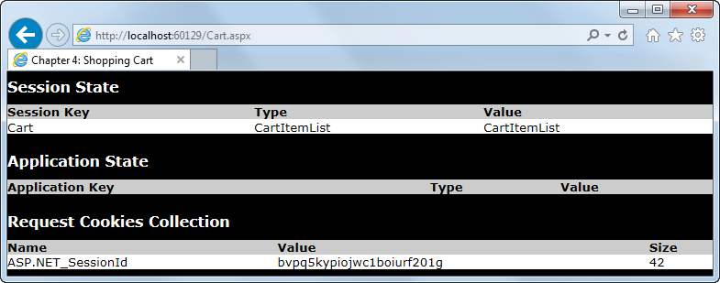
The session and cookies information for the Cart page

Slide 24
A Page directive that enables tracing

Slide 25
Common property of the TraceContext class

Slide 26
Code that writes a custom trace message

Slide 27
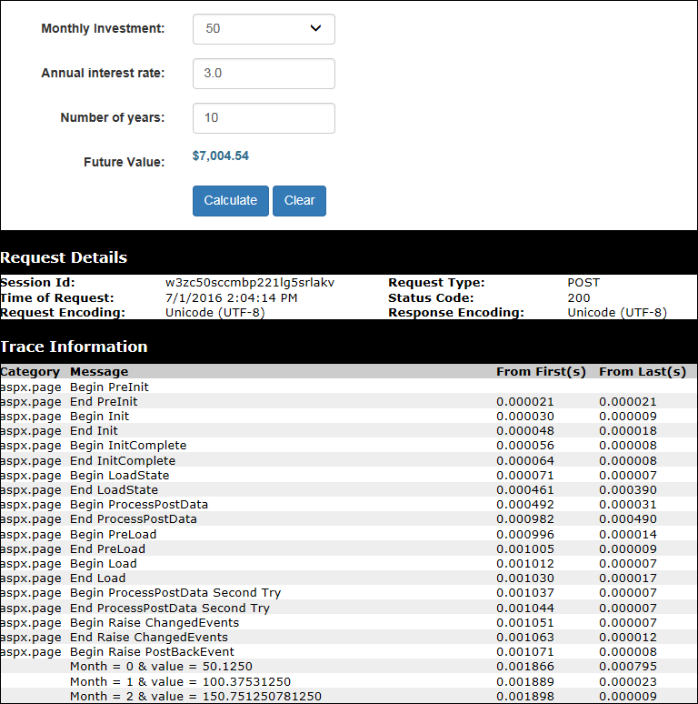
Extra 5-1 Trace the Future Value application

